Slide 1
Guarded Remittance System Employing WANET for Catastrophe Region
PROJECT GUIDE
Mr.BALASUNDARAGANAPATHY
(Asst. Professor)
YOKESHWARAN.T (211414205124)
VENUGOPAL.S (211414205118)
NISHANTH.M (211414205066)
MANOJ.S (211414205048)

Slide 2
Abstract
We propose an offline mobile payment system for catastrophe region utilizing WANET (Wireless Adhoc Network).
The current payment system requires a fixed infrastructure network such as cellular towers or wired network for transactions. But in Disaster areas, these infrastructures may not be ruined.
To overcome this issue, we developed an mobile payment application in android to make payment offline. We create an infrastructure less wireless network such as WANET for communication and make mobile payment possible in offline.
We use Multilevel Endorsement Mechanism to ensure guarantee payment for merchant.
In order to make transaction easier and secured, QR codes with digital signatures are used to restrict an attacker from double spending it.
In addition to payment system, region situation update is provided for users to upload disaster information such as roadblocks, floods etc.

Slide 3
Literature Survey
S.No | Title | Author Name | Publication Date | Merit | De-merit
1 | An Endorsement-based Mobile Payment System for a Disaster Area | Babatunde Ojetunde, Naoki shibata, Juntao Gao, Minoru Ito | 22 May 2015 | Endorsement-based mechanism provides guaranteed payment | Uses only MANET network for communication
2 | Implication of Secure Micropayment System Using Process Oriented Structural Design by Hash chaining in Mobile Network | Chitra KiranN, Dr. G. Narendra Kumar | 2 jan 2012 | Uses WANET for data transfer which is flexible and reliable | Only Hash algorithm is used for security purpose

Slide 4
S.No | Title | Author Name | Publication Date | Merit | De-merit
3 | An efficient and secure mobile payment protocol for restricted connectivity scenarios in vehicular ad hoc network | Wenmin Li, Qiaoyan Wen, Qi Su and Zhengping Jin | 5 September 2011 | Introduced an new protocol for data transfer in VANET which is security and efficiency | Utilizes only VANET for communication
4 | Off-line Micro-payment Protocol for Multiple Vendors in Mobile Commerce | Xiaoling Dai, Oluwatomi Ayoade and John Grundy | 19 December 2006 | The mesh users utilize heterogeneous wireless devices | Wireless Mesh Networks stores routing information for data delivery which consumes time.

Slide 5
Existing System
In current payment system user can only make payment with the help of Internet connection or Cellphone tower.
Mobile payment system uses any one of the following techniques:
Mobile wallets
Card-based payments
Carrier billing (Premium SMS or direct carrier billing)
Contactless payments NFC(Near Field Communication)
Direct transfers between payer and payee bank accounts
But all the above listed ways requires Internet connection or at least Network connection.
If the connectivity is not available especially in disaster timing, then online transaction is not possible.

Slide 6
Proposed System
We proposed a payment system that will provide the infrastructure less network between user and bank during disaster time using WANET network.
We use transceivers for the communications between mobiles and banks in order to cover a wider range of communication.
The customer mobiles passes the payment messages consisting of merchant information and his payment amount across the mobiles using transceiver as a QR code which contains the payment info.
We use QR code transaction with a digitally signed photograph which is used for authentication and to restrict an attacker from carrying duplicate QR code transaction.

Slide 7
This information bounces to other mobiles until it reaches the Bank and the Bank response message reaches the customer using same strategy.
In order to provide payment guarantees for merchant we use Multilevel Endorsement Mechanism (MLE) for customer-to-merchant.
To reduce communication overheads we used lightweight scheme based on Bloom filter and Merkle tree.
The merchant scans the QR-code and sends information back to the bank and the finally the amount is credited.
At last we provide regional situation updates for the users to broadcast any information such as Roadblocks, Bridge Collapse and flood affected areas.

Slide 8
Software Requirements
Windows:
Operating System : Windows 7 and above (64-bit).
Java Version : JDK 1.7
Web Server : Tomcat 6.20
Database : MYSQL Front
Smart Phone:
Operating System : Gingerbread and above.
No. of Devices : 2(at least).

Slide 9
Hardware Requirement
Windows:
Hard disk : 250 GB and above.
Processor : i3 and above.
RAM : 2GB and above.
Smart Phone:
Memory : 4GB and above.
Processor : Dual core and above.
RAM : 500 MB and above.

Slide 10
Architecture Diagram

Slide 11
Modules List
Bank Account Creation
Customer Payment Request
Merchant Process
Region Situation Update

Slide 12
Module Description
Bank Account Creation
In this module customer and merchant will create a bank account and sign up in the application.
Our application need the users to hold a bank account for transaction.
Additionally customers has to give their endorser name (surety).
This will help the customer to withdraw amount from their endorser account if customer account has minimum balance.

Slide 13
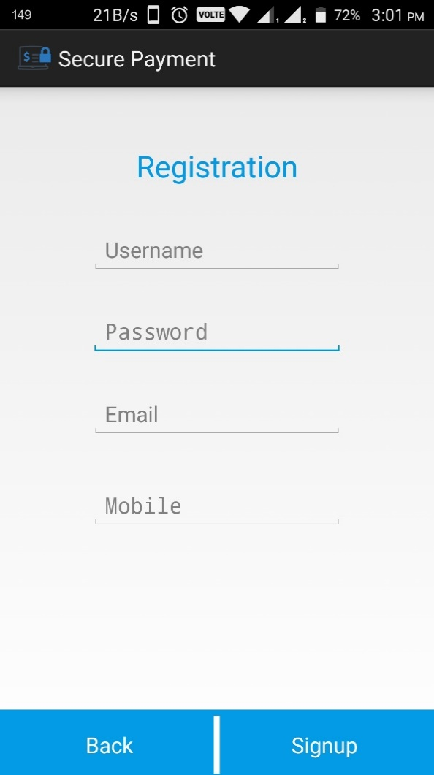
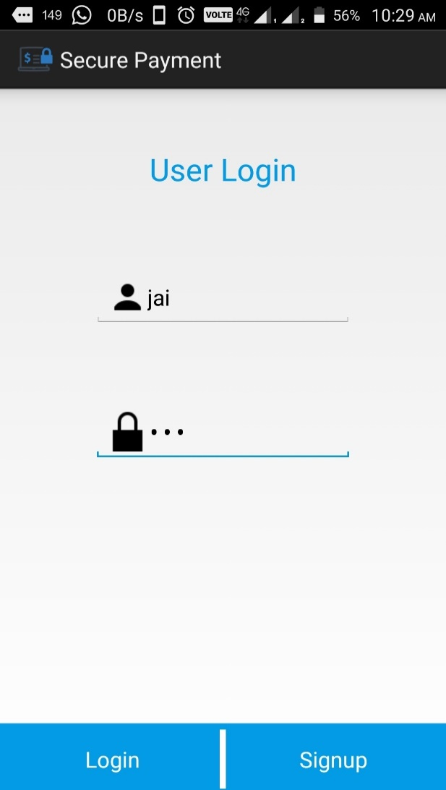
Screen Shots
Customer & Merchant Registration page:
Customer Login Page:

Slide 14
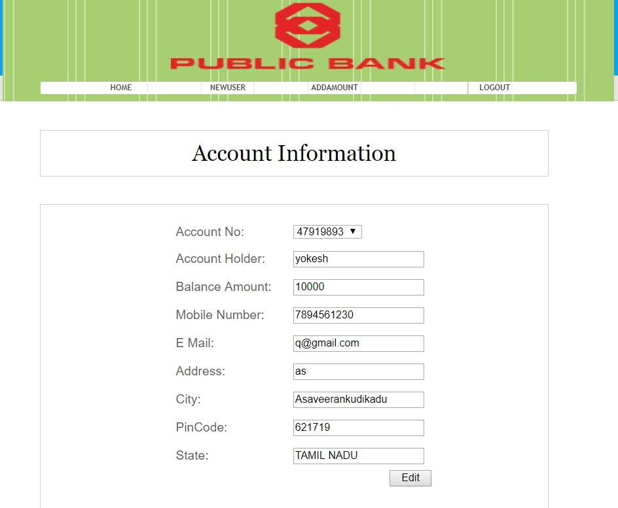
Bank Interface

Slide 15
Customer Payment Request
Second module shows how the purchase is made by the customer.
First the User will login with credential information like username, password and if it is valid then it opens the User profile screen.
If Customer wants to purchase any item then he should scan the Merchant Shop QR code and then customer has to enter the Item name and cost of item.
Then the information will be encoded with the DES Algorithm and then the encoded data will be converted into stream of bits using Base 64 Algorithm.
It will be broadcasted from the customer phone and by using mobile to mobile communication the data reaches the Bank.
The data is verified by the bank and if data is valid Bank generates a QR code and send it back to the customer who made the request.

Slide 16
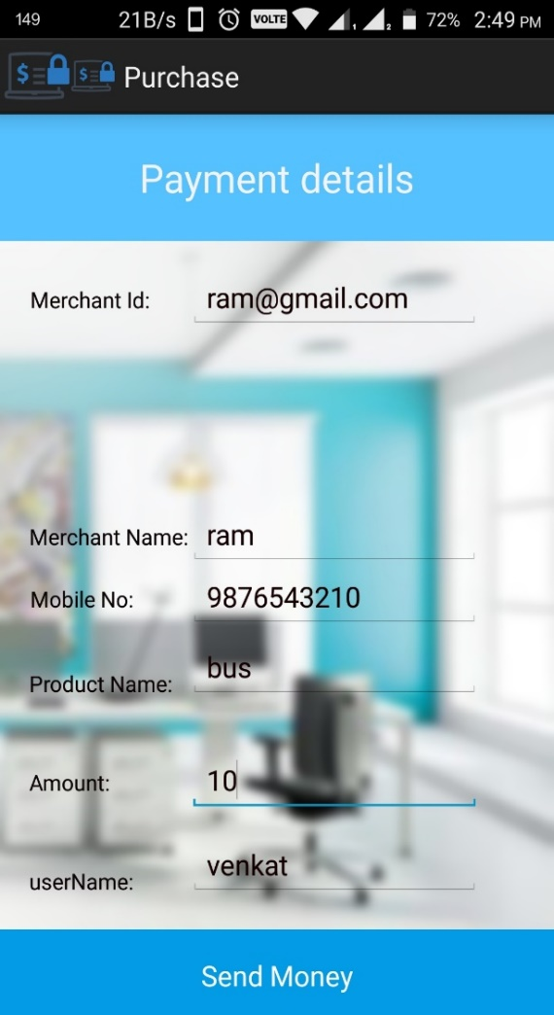
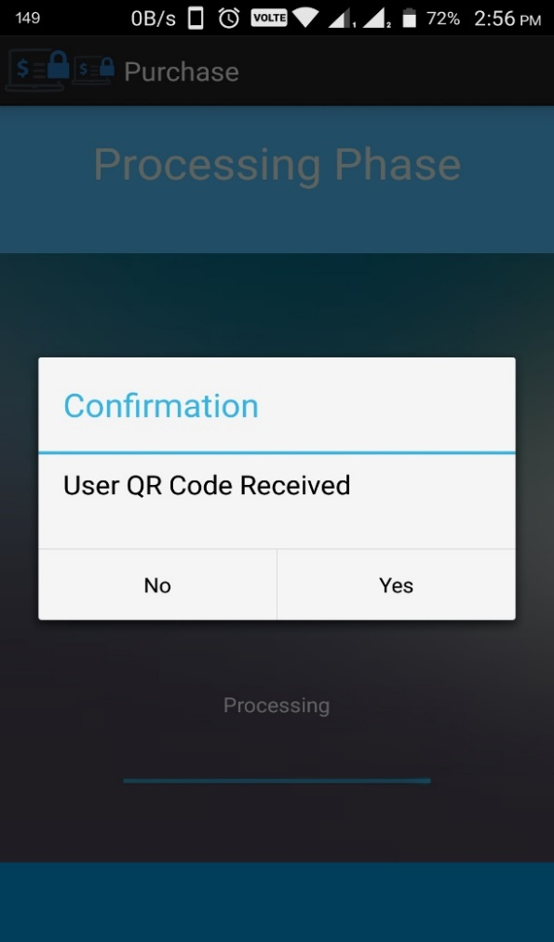
Screen Shot
Customer Payment Page
Customer Received QR Code from Bank

Slide 17
Merchant Process
In this module the received QR code will be scanned by the Merchant from the customer.
The QR code contains the account information and transaction amount with digital signature.
If the merchant scans the customer QR code the data is proceed to Bank through mobile communication using WANET.
Bank system will check the QR code information and validates using parameters such as Date, Signature, and Time.
After the successful verification, the amount will be transferred from customer to merchant account and this completed transaction will be informed to the merchant.
When the transaction is completed the used QR code will become invalid to avoid Double Spending.

Slide 18
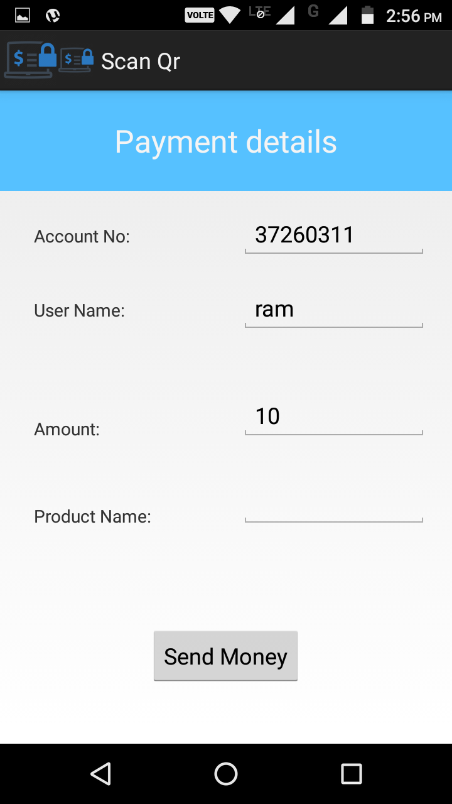
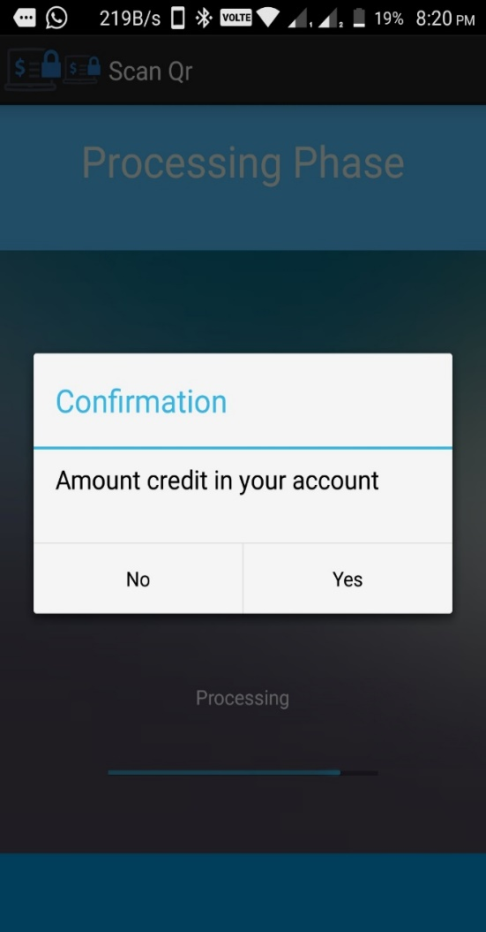
Screen Shot
Merchant Scans the QR Code:
Acknowledgment Message to Merchant:

Slide 19
Region Situation Update
In this final module we will be providing a page where the user can upload their surrounding situation.
Now all the user will be connected in WANET network. So any update made by any user will be passed to all other users.
The update is made based on their location situation like heavy rain, road block. So this location update will be very helpful to all the people who travels or rescuers by checking the update.
User can also broadcast emergency message and call for rescue which will be useful for the victims in disaster area.
The situation update can be given in three fields such as subject, place and status. Once the user update their Information, other user can view region information in their application.

Slide 20
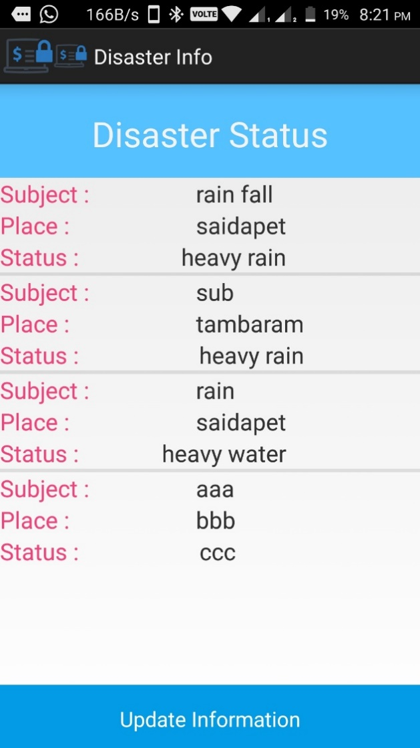
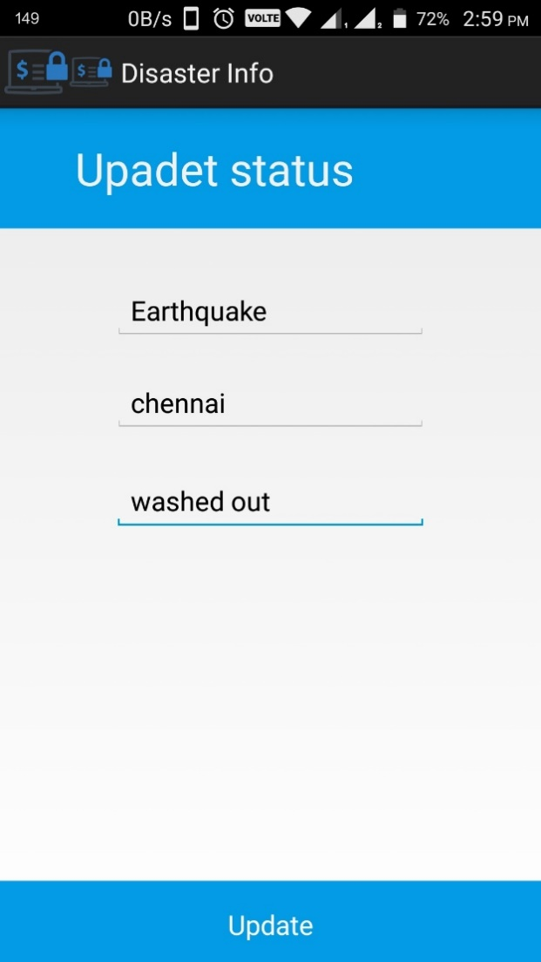
Screen Shot
Disaster Information
Disaster Update Page

Slide 21
Algorithms And Methodologies
1. DES Algorithm
2. Base 64
3. QR code

Slide 22
DES Algorithm
In this paper, the DES algorithm is used to prevent the attack from hackers during transmission of user information.
DES(Data Encryption Standard) is a symmectric key block cipher published by the National Institute of Standards and Technology(NIST).DES is an implementation of a Feistel Cipheer. It uses 16 round Fesitel structure.
The block size is 64-bit. Though, key length is 64-bit,DES has an effective key length of 56bits.
General Structure of DES is depicted in the following illustration.Since DES is based on the Feistel Cipher, all that is required to specify DES is
i) Initial and final permutation
ii) Round Function
iii) Key Expansion

Slide 23
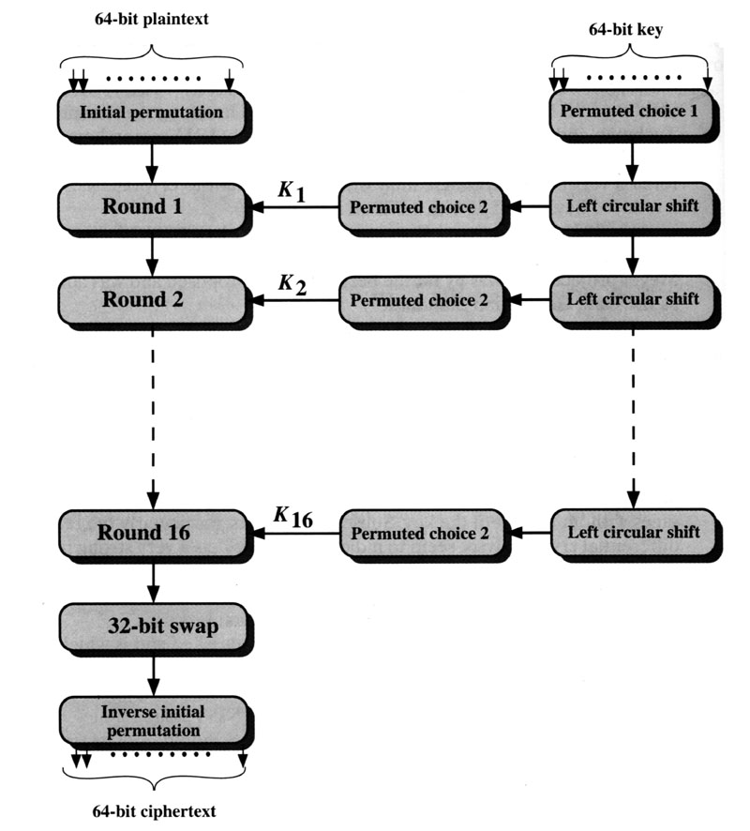
Encryption

Slide 24
Encryption (cont.)
64-bit plaintext (X)
Initial Permutation (IP)
64-bit key (K)
Key _{i}
Round _{(i)}
Key Generation (KeyGen)
32-bit Switch (SW)
Inversion of Initial Permutation (IP⁻¹)
64-bit ciphertext (Y)

Slide 25
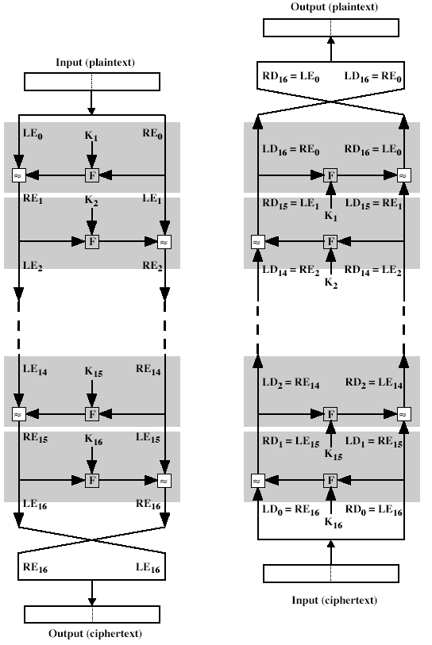
Decryption
The same algorithm as encryption.
Reversed the order of key (Key₁₆, Key₁₅, … Key₁).
For example:
IP undoes IP⁻¹ step of encryption.
1st round with SK16 undoes 16th encrypt round.
[1]

Slide 26
Base64 Algorithm
Base64 also be referred as Privacy-enhanced Electronic Mail(PEM) is used to convert binary data into a text-like format that allows it to be transported in environments that can handle only text safely.
Base64 encoding takes the original binary data and divides it into tokens of three bytes(24 bits) and converted into printable characters from the ASCII standard.
The first step is to take the three bytes (24bit) of binary data and split it into four numbers of six bits.
Because the ASCII standard defines the use of seven bits, Base64 only uses 6 bits (corresponding to 2^6 = 64 characters) to ensure the encoded data is printable and none of the special characters available in ASCII are used.
The ASCII characters used for Base64 are the numbers 0-9, the alphabets 26 lowercase and 26 uppercase characters plus two extra characters '+' and '/‘(26+26+10+2=64).

Slide 27
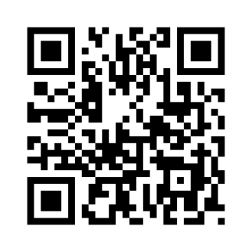
QR Code
QR code means Quick Response Code is the trademark for a type of Matrix Barcode first designed for the automotive industry in Japan.
A QR code consists of black squares arranged in a square grid on a white background which can be read by an imaging device and processed using Reed-Solomon error correction.
The required data is then extracted from patterns that are present in both horizontal and vertical components of the image.
It can be designed for Storage, Error correction, Encoding and Decoding.

Slide 28
References
Publication year | References
2015 | B. Ojetunde, N. Shibata, J. Gao, and M. Ito, “An endorsement-based mobile payment system for a disaster area,” in Proc. 29th IEEE Int.Conf. Adv. Inf. Netw. Appl. (AINA), Gwangju, South Korea, Mar. 2015, pp. 482–489.
2015 | Y. Meier, J. Xu, O. Atan, and M. van der Schaar, “Personalized grade prediction: A data mining approach,” in Data Mining (ICDM), 2015 IEEE International Conference on. IEEE, 2015, pp. 907–912.
2015 | C. G. Brinton and M. Chiang, “Mooc performance prediction via clickstream data and social learning networks,” in 2015 IEEE Conference on Computer Communications (INFOCOM). IEEE, 2015, pp. 2299– 2307.
2012 | W. Li, Q. Wen, Q. Su, and Z. Jin, “An efficient and secure mobile payment protocol for restricted connectivity scenarios in vehicular ad hoc network,” Comput. Commun., vol. 35, no. 2, pp. 188–195, Jan. 2012.

Slide 29
Publication year | References
2010 | KDD Cup, “Educational data minding challenge,” https://pslcdatashop: web:cmu:edu/KDDCup/, 2010.
2006 | X. Dai, O. Ayoade, and J. Grundy, “Off-line micro-payment protocol for multiple vendors in mobile commerce,” in Proc. 7th Int. Conf. Parallel Distrib. Comput. Appl. Technol. (PDCAT), Taipei, Taiwan, 2006, pp. 197–202
2005 | Y.-Y. Chen, J.-K. Jan, and C.-L. Chen, “A novel proxy deposit protocol for e-cash systems,” Appl. Math. Comput., vol. 163, no. 2, pp. 869–877,2005.
2004 | V. Patil and R. K. Shyamasundar, “An efficient, secure and delegable micro-payment system,” in Proc. IEEE Int. Conf. e-Technol. e-Commerce e-Service (EEE), Taipei, Taiwan, Mar. 2004, pp. 394–404.
2003 | A. Mishra and K. M. Nadkarni, “Security in wireless ad hoc networks,” in The Handbook of Ad Hoc Wireless Networks. Boca Raton, FL, USA: CRC Press, 2003, ch. 30, pp. 499–549.

Slide 30
Publication Details
Paper Title | Guarded Remittance System Employing WANET for Catastrophe Region
Authors | Mr.Balasundaraganapathi.N, Yokeshwaran.T, Venugopal.S, Nishanth.M, Manoj.S
Journal Name | International Research Journal of Engineering and Technology (IRJET)
Edition | Volume: 05 Issue: 03
Month and Year | April 2018

Slide 31
Thank You

